Slide 1


“SPOTIFY DATA ANALYSIS”
Submitted in partial fulfilment of the requirements for the award of the degree of
Bachelors of Computer Application
TO
Guru Gobind Singh Indraprastha University, Delhi
Institute of Innovation in Technology & Management
New Delhi- 110058

Slide 2
Trainer: Mr. Divyank Chauhan Submitted by: Manvi Rana
Sneha Rajbhar
Sanskriti
Sakshi Mishra
Faculty: Mrs. Kanika Dhingra

Slide 3
PYTHON Introduction
Interpreted language
Use: Web development, data analysis, machine learning, automation
Dynamic Typing
Executed line by line
Lots of resources and libraries
Can work on different platforms : Windows, Linux, MacOS

Slide 4
OPERATORS
ARITHMETIC :
+ : Addition
- :Subtraction
* : Multiplication
/ : Division
** :Exponentiation
% : Modulus
// :Floor Division
ASSIGNMENT :
= : Assign value
+= : Add and assign
-= : Subtract and assign
*= : Multiply and assign
/= : Divide and assign
COMPARISON :
== : Equal To
!= : Not equal to
> : Greater than
< : Less than
>= : Greater than or equal to
<= : Less than or equal to

Slide 5
OPERATORS
LOGICAL :
and : Logical AND
or : Logical OR
not : Logical NOT
BITWISE :
& : Bitwise AND
| : Bitwise OR
^ : Bitwise XOR
~ : Bitwise NOT
MEMBERSHIP :
in : Value is in the sequence
not in : Value is not in the sequence
IDENTITY :
is : Objects are the same object
is not : Objects are not the same object

Slide 6
CONTROL STATEMENTS
if Statement :
Use: Conditional execution
Syntax:
if condition:
#code to execute
elif Statement :
Use: Check additional conditions if the initial “if” is False
Syntax:
if condition1:
# code if condition1 is True
elif condition2:
# code if condition2 is True
elif condition3:
# code if condition3 is True
else Statement :
Use: Execute code when all preceding conditions are False
Syntax:
if condition:
# code if condition is True
else:
# code if condition is False

Slide 7
LOOPS
FOR Loop:
Syntax :
for variable in iterable:
# code to execute for each item
Example :
for i in range(5):
print(i)
Output :
0, 1, 2, 3, 4
WHILE loop:
Syntax :
while condition:
# code to execute while condition is True
Example :
i = 0
while i < 3:
print(i)
i += 1
Output :
0
1
2

Slide 8
CONTINUE, BREAK STATEMENT
CONTINUE :
Example :
for i in range(5):
if i == 3:
continue
print(i)
Output :
0
1
2
4
BREAK :
Example :
for i in range(5):
if i == 3:
break
print(i)
Output :
0
1
2

Slide 9
FUNCTIONS
Built in Functions :
Pre-existing functions.
Example :
lst= [1, 2, 3, 4, 5]
length = len(lst)
print(length)
Output :
5
User Defined Functions :
These functions are created by user.
Example :
def sum(a,b):
sum=a+b
print(sum)
sum(2,3)
Output :
5

Slide 10
STRING
Definition: Ordered, immutable sequences of characters.
Syntax : String_name= ‘Content’
Example : str= ‘Trendwave’
Various operations that can be performed: strip() , split() , join() , replace()
upper() : Convert all characters to uppercase.
str.upper()
Result : TRENDWAVE
lower() : Convert all characters to lowercase.
str.lower()
Result : trendwave
find() : Returns the index of first occurrence of a character
str.find(e)
Result : 2
count() : Counts the number of times a character occurs.
Str.count(e)
Result : 2

Slide 11
LISTS
Definition: Ordered, mutable collections of items that can be of any data type.
Syntax: list_name=[value1, value2, value3….]
Example : lst=[1,2,3,4]
Various operations that can be performed: sort() , reverse() , extend() , clear() , index() , count()
append() : Add an item to the end of the list.
lst.append(5)
Result : lst=[1,2,3,4,5]
insert() : Add an item at a specific location.
lst. insert(1, ”add")
Result : lst=[1,add,2,3,4,5]
remove() : Remove the first occurrence of an item
lst.remove(2)
Result : lst=[1,add,3,4,5]
pop() : Removes and returns the last item (or value at a specific location if mentioned).
lst.pop(1)
Result : add #lst=[1,3,4,5]
lst.pop()
Result : 5 #lst=[1,3,4]

Slide 12
TUPLES
Definition: Ordered, immutable collections of items that can be of any data type.
Syntax:
list_name=(value1, value2, value3….)
Various Operations performed on Tuples:
Example :
tpl= (1, 2, ”A", ”B", 3)
count() : Count the number of occurrence of an element
tpl.count(3)
Result : 1
index() : Returns the index of first occurrence of an element
tpl.index(3)
Result : 4
len() : Returns the number of elements in the tuple.
tpl.len()
Result : 5
slicing() : Retruns a subset of the tuple according to requirement
tpl[1:3]
Result : 2,A

Slide 13
DICTIONARY
Definition: Mutable collections of key-value pairs.
Syntax : Dictionary_name= {”Key1": ”Value1", ”Key2": Value2, …}
Example : dct= {1: “Apple", 2: “Mango”, 3:”Grapes”}
Various Operations performed on Dictionary: pop() , popitem() , update()
keys() : Returns all the keys in a dictionary.
dct.keys()
Result : 1,2,3
items() : Returns all the key-value pairs.
dct.items()
Result : 1: “Apple", 2: “Mango”, 3:”Grapes”
clear() : Removes all the key-value pairs from the dictionary.
dct.clear()
Result : #Empty dictionary
get() : Return the value of the given key.
dct.get(1)
Result : Apple

Slide 14
ADVANCED EXCEL
Different Logical Functions In Excel :
IF(): Returns a value based on condition.
Syntax: =IF(condition, “If condition True", "If condition FALSE”)
IFS() : Apply multiple If statements.
Syntax: =IFS(condition1, “If condition1 True”, condition2, “If condition2 True”,” condition3, “If condition3 True”)
AND() : Returns a value if both given conditions are satisfied.
Syntax: =IF(AND(condition1, condition2) “If condition True", "If condition FALSE”)
OR() : Returns a value if either of the conditions are satisfied.
Syntax: =IF(OR(condition1, condition2) “If condition True", "If condition FALSE”)
NOT() : Reverses the logic
Syntax: =IF(NOT(condition), “If condition True", "If condition FALSE”)

Slide 15
ADVANCED EXCEL
Lookup Functions In Excel :
VLOOKUP(): It is performed vertically.
Syntax: =VLOOKUP(find_data, where_to_find_data : value_returned_from, no_of_columns_used , FALSE/TRUE)
HLOOKUP() : It is performed horizontally.
Syntax: = HLOOKUP(find_data, where_to_find_data : value_returned_from, no_of_columns_used , FALSE/TRUE)
XLOOKUP() : It can search in any direction
Syntax: =XLOOKUP(data_to_search, where_to_search_range , where_to_return_from)
Some more functions:
TODAY() , NOW() , SUMIF() , COUNTIF() , AVERAGEIF() , ROUND() , INT()

Slide 16
PYTHON LIBRARY: sqlite3
Easy to use
Self contained
Transactional
Importing:
Syntax: import sqlite3 as sq
Operations:
Connecting to database
Creating a cursor
Executing queries
Fetching resluts

Slide 17
PYTHON LIBRARY: sqlite3
Example:
import sqlite3 as sq #import library
conn = sq.connect(‘abc.db’) #connecting the database
cursor = conn.cursor() #creating a cursor
cursor.execute('INSERT INTO users (name, age) VALUES (?, ?)', ('John Doe', 30)) #inserting data
conn.commit() #commit the queries
conn.close() #closing the connection
cursor.execute('UPDATE users SET age = ? WHERE name = ?', (31, 'John Doe’)) #updating the data

Slide 18
PYTHON LIBRARY: NumPy
Can be used to create multidimensional arrays.
Perform operations on entire arrays at once.
Help to keep code concise and faster.
Wide variety of mathematical functions.
Importing:
Syntax: import numpy as np
Usecase:
Scientific Computing
Data Science
Engineeering
Some functions:
np.array() : Creates an array.
np.sum() : Calculates sum of an arary.
np.mean() : Calculates the mean of an array.
np.min() : Finds the minimum value in an aray.
np.max() : Finds the maximum value in an array.
np.dot() : Calculates the dot product of two arrays.

Slide 19
PYTHON LIBRARY: Pandas
Dataframes can be created.
Data Cleaning
Data merging and joining.
Importing:
Syntax: import pandas as pd
Creating Dataframe :
data = {'Fruits': ['Mango', 'Apple'], 'Vegetables': ['Potato', 'Carrot']}
df = pd.DataFrame(data)
Use cases:
Data analysis
Data Science
Buisiness Intelligence
Data merging and joining.
Some functions:
pd.read_csv() : Reads a CSV file into a DataFrame.
df.head() : Displays the first few rows of a DataFrame.
df.info() : Provides a summary of a DataFrame's structure and data.
df.groupby() : Groups a DataFrame by one or more columns for aggregation.
df.merge() : Merges two DataFrames based on a common column.
df.dropna() : Removes rows with missing values from a DataFrame.

Slide 20
PYTHON LIBRARY: Matplotlib, Seaborn
Matplotlib :
Static, animated and interactive visualizations.
Used to created graphs, charts, plots.
Importing:
Syntax: import matplotlib.pyplot as mp
Usecase:
Data analysis
Scientific computing
Seaborn :
Focused on statistical visualization.
Higher version of Matplotlib
Importing :
Syntax: import seaborn as sb
Use cases:
Data science
Statistical analysis
Exploratory data analysis

Slide 21
DATA CLEANING
Step 1 :Import Libraries
import pandas as pd
Step 2 :Import File as a dataframe
file = pd.read_csv('spotify_history.csv')
df = pd.DataFrame(file)
Step 3 :Retrieve basic information and summary
df.info()
df.describe()
step 4: Handling Missing Data values in reason_end and reason_start
df['reason_end'] = df['reason_end'].fillna('Unknown')
df['reason_start'] = df['reason_start'].fillna('Unknown’)
Step 5: Handling wrong values
Replace 'Not Available' in ts
df['ts'] = df['ts'].replace('Not Available', pd.NaT)
Convert to datetime
df['ts'] = pd.to_datetime(df['ts'], errors='coerce’)
Step 6: Clean text columns
df['track_name'] = df['track_name'].str.strip()
Step 7: reindex & sort
df.reset_index(drop=True, inplace=True)
Step 8 : save cleaned data
df.to_csv("cleaned_data.csv", index=False)

Slide 22
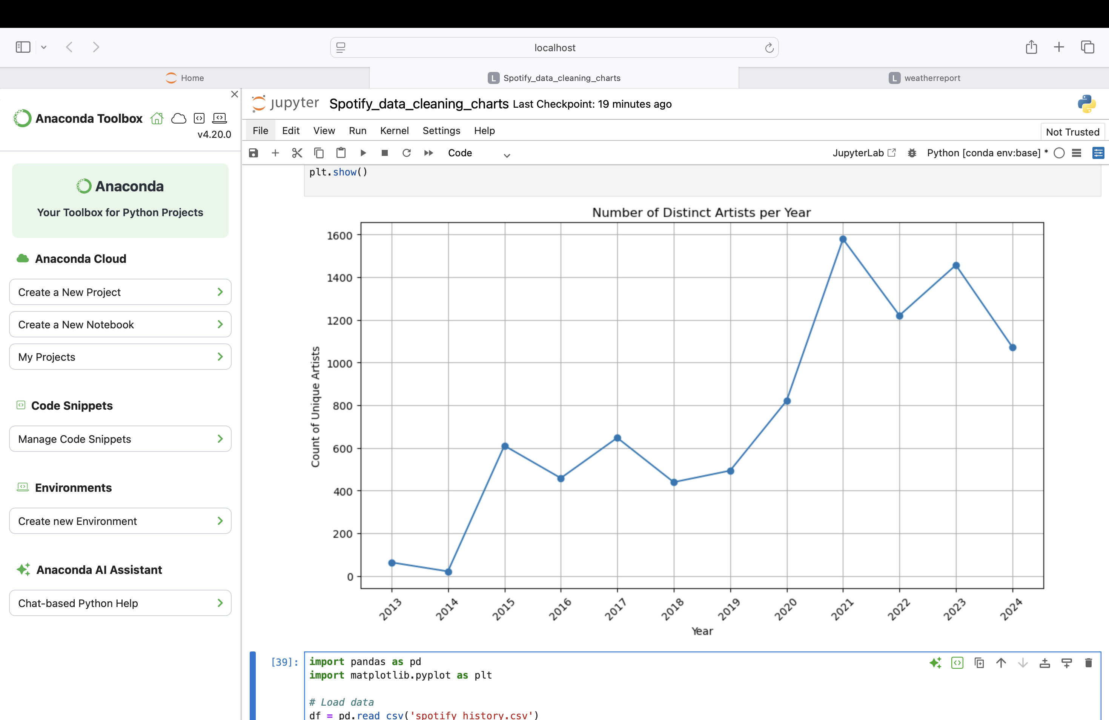
Graph
import pandas as pd
import matplotlib.pyplot as plt
df = pd.read_csv('spotify_history.csv')
df['ts'] = pd.to_datetime(df['ts'])
df['year'] = df['ts'].dt.year
artist_counts_per_year = df.groupby('year')['artist_name'].nunique()
plt.figure(figsize=(10,6))
plt.plot(artist_counts_per_year.index, artist_counts_per_year.values, marker='o', linestyle='-')
plt.title('Count of Distinct Artists per Year')
plt.xlabel('Year')
plt.ylabel('Count of Unique Artists')
plt.grid(True)
plt.xticks(artist_counts_per_year.index, rotation=45) # rotate years if needed
plt.tight_layout()
Plt.show()

Slide 23
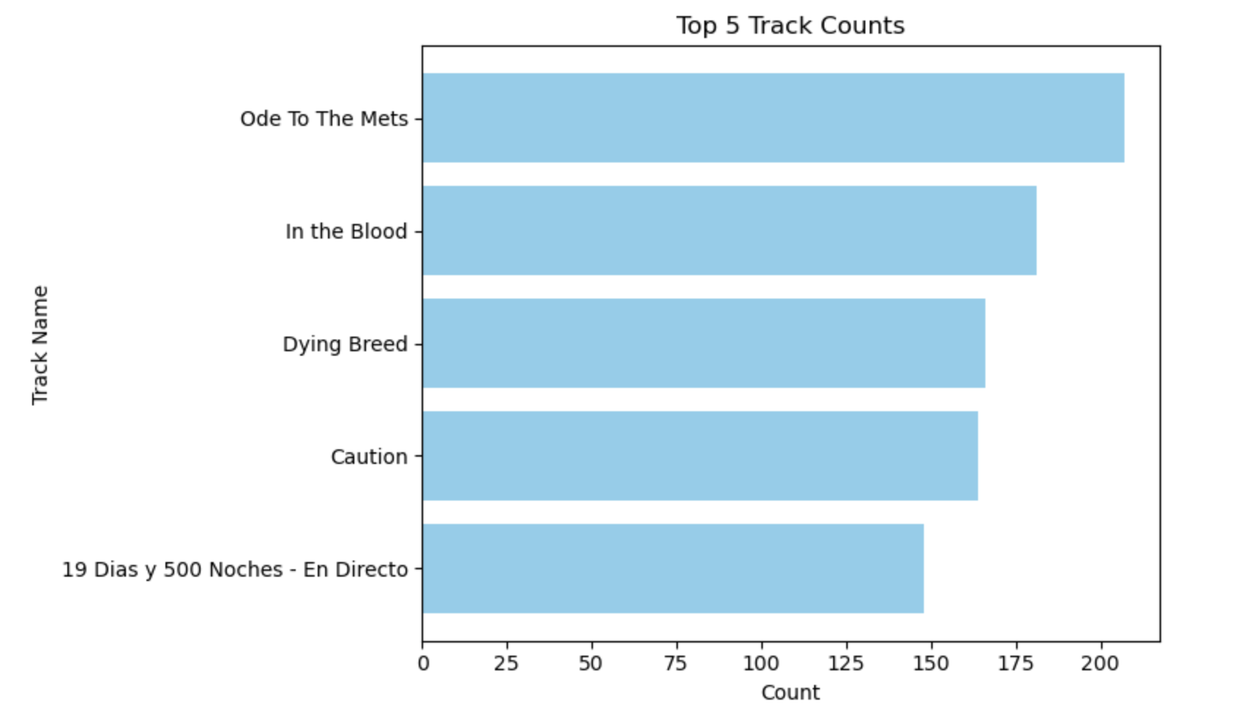
Graph
import pandas as pd
import matplotlib.pyplot as plt
df = pd.read_csv('spotify_history.csv')
track_counts = df['track_name'].value_counts()
top_5_tracks = track_counts.head(5)
plt.figure(figsize=(8,5))
plt.barh(top_5_tracks.index, top_5_tracks.values, color='skyblue')
plt.xlabel('Count')
plt.ylabel('Track Name')
plt.title('Top 5 Track Counts')
plt.gca().invert_yaxis() # Highest count on top
plt.tight_layout()
plt.show()

Slide 24
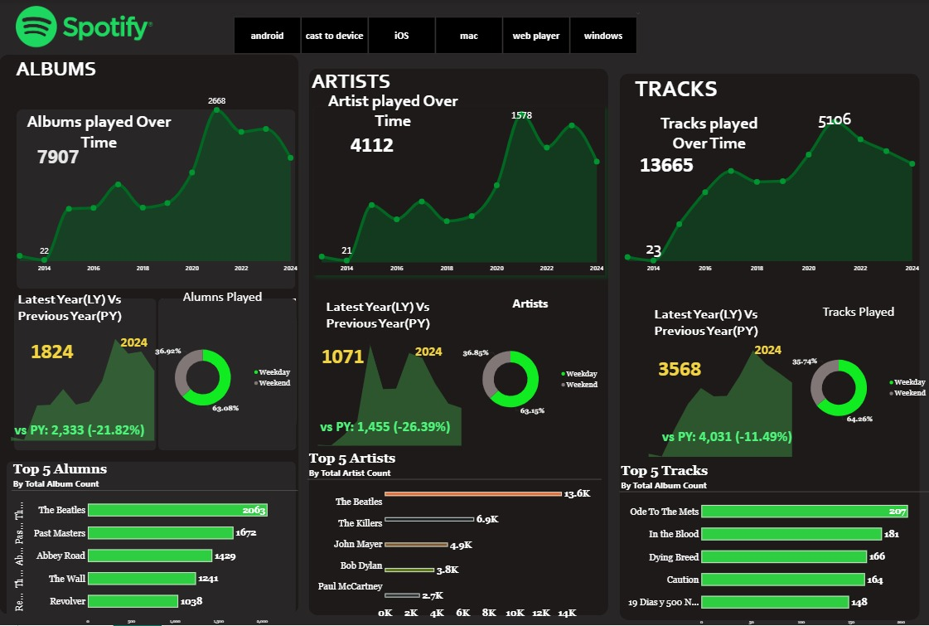

Slide 25
INSIGHTS
There is a decline in all three categories in terms of listening activities :
Albums
Artists
Tracks
2. The donut chart for all three categories shows that there is more listening activities during the weekdays compared to the weekends.
3. The bar chart for artists reveals that “The Beetles” is the top artist with 13.6 K listeners.
4. The bar chart for albums reveals that the top album belongs to “The Beetles” with 2063 album play count.
5. The bar graph for tracks reveal that “Ode To The Mets” is the most played track.

Slide 26
BUISINESS REQUIREMENT
It is necessary improve platform services.
Helps in providing personalized service : Based on the data, new artists and tracks are recommended.
The data can be used to inform business decisions, such as identifying trends in music consumption and optimizing content offerings.
Spotify can use user listening data to deliver targeted advertisements, increasing the effectiveness of ad campaigns.
The platform can develop features that help users discover new music, such as "Discover Weekly” or “The upcoming trends”
Artist Partnerships: Spotify can partner with artists and labels to promote their music and provide exclusive content to users.
The analysis is important for the business to decide if the business is facing issues, and if they have to take actions for the same.

